Slide 1




Understanding Two-Factor Authentication
HR Professionals delivering HR technology
www.hrwize.com

Slide 2
What is Two-Factor Authentication?
Two-Factor Authentication (2FA) is a security measure that requires users to verify their identity through multiple methods before gaining access to a system. It combines two or more authentication factors, such as something you know (a password) or something you have (a smartphone or security token). By requiring multiple forms of verification, 2FA significantly reduces the risk of unauthorized access.
Authenticator apps generate time-based codes on a trusted device and are less susceptible to phishing, forwarding, or interception, than codes sent via email.
Email 2FA may be used for your employee access to the system, however, this depends on the security of the email account; if the inbox is compromised, the one-time code may also be exposed. Therefore, Authenticator is our most secure method and is the default for high‑privilege roles (Admins/Managers).
www.hrwize.com

Slide 3
What is Two-Factor Authentication?
Implementing 2FA enhances the security of your accounts by adding an extra layer of protection beyond just a password. For example, even if a password is compromised, an attacker would still need access to the additional authentication method, such as a code sent to your phone or an approval through an authenticator app. This makes it a highly effective tool in preventing cyberattacks and safeguarding sensitive information.
Please note:
If you're currently using Single Sign-On (SSO) to access your systems, Two-Factor Authentication (2FA) should still be implemented as the initial access point to your local network. This setup should not be configured within your HRWize system.
Instead, 2FA must be set up within your own network environment. We strongly recommend consulting with your local IT team to ensure this is correctly configured.
www.hrwize.com

Slide 4
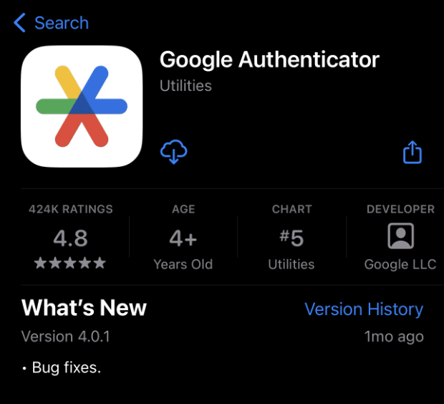
Installing and using an authenticator to access your system
Using an authenticator app to access your system
Setting up and using an authenticator app is a straightforward process that enhances the security of your account. This guide will walk you through the necessary steps to configure an authenticator app for two-factor authentication (2FA).
Downloading an authenticator app to your mobile device
                You can download an authenticator app on any smart device, such as a smart phone or tablet. We recommend downloading a reputable authenticator app like Microsoft Authenticator or Google Authenticator or . These can be downloaded onto your mobile device via Android or iOS stores, dependent on your mobile platform.
www.hrwize.com

Slide 5
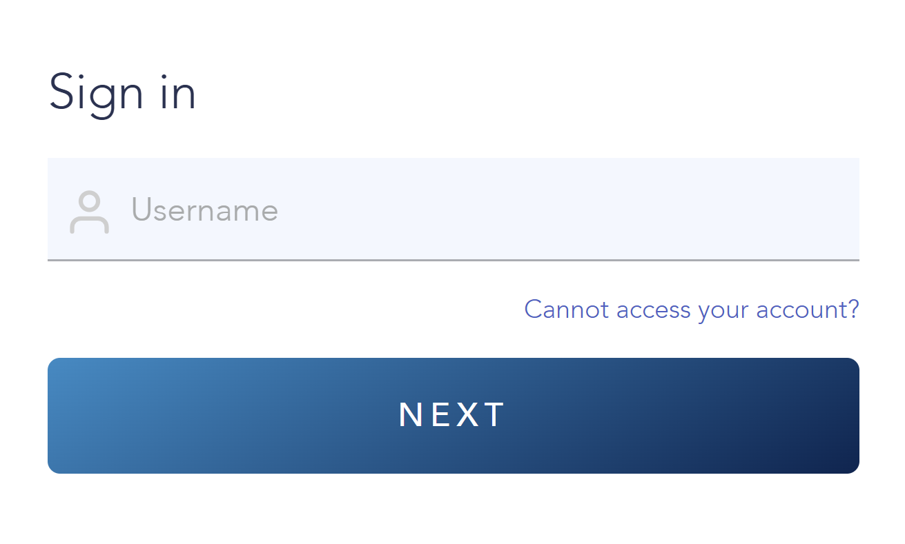
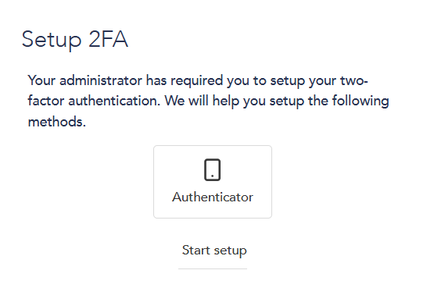
Register the authenticator for use with your system profile
When an employee (Admin, HR or Manager users) attempts to log in after the 2FA has been turned on in your system, they will see the below screen to help them set up their authenticator app. The employee will click on start setup from this screen.
www.hrwize.com

Slide 6
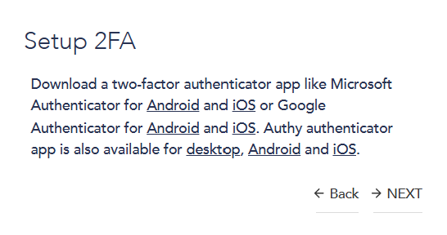
Authenticator app reminder
Once they have selected start setup, they will then see a screen reminding them to download and install an approved authenticator app.
www.hrwize.com

Slide 7
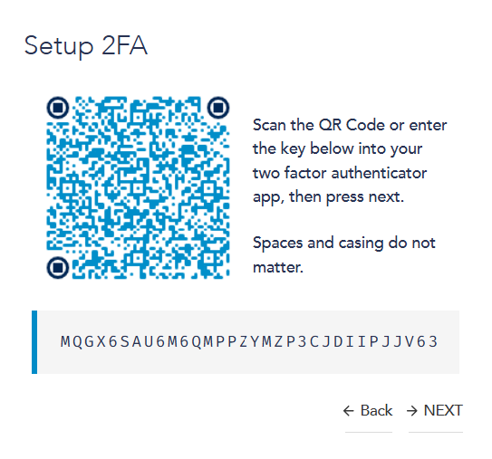
Scan QR Code and Verify
The system will display a QR code on your screen. Open the authenticator app on your mobile device and use its scanning feature to scan the QR code. This will link the app to your account and generate a unique authentication code.
www.hrwize.com

Slide 8
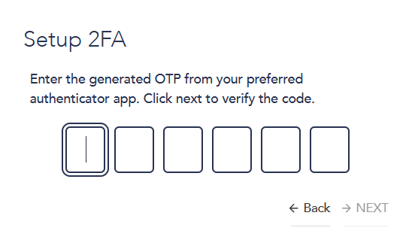
Enter the authentication code
Enter the authentication code displayed in the app into the portal to verify the setup. Once verified, your authenticator app will be successfully configured, and you can use it for secure logins moving forward.
www.hrwize.com

Slide 9
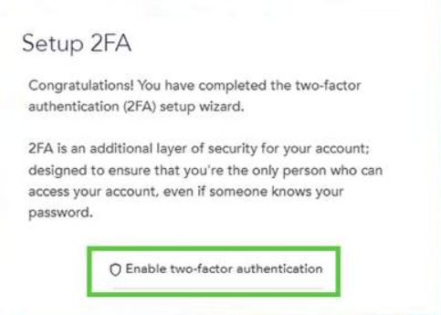
Successful setup of app
Once the app has been successfully linked to the system, they will see the message displayed here. They should then click on the Enable two-factor authentication button in the message and access their system.
www.hrwize.com

Slide 10
Summary of Authenticator Setup
By following these steps, you have successfully set up an authenticator app for multi-factor authentication. This added layer of security ensures that your account remains protected against unauthorized access. Every time your employee logs into your system, the employee will go into the authenticator app and enter the generated code as part of their log in process.
www.hrwize.com

Slide 11



CONTACT
1425 Trans-Canada Highway,
Dorval, Québec H9P 2W9,
Suite 020B
Thank you!
Kindly contact us if you have any questions
Support
support@hrwize.com
www.hrwize.com

